Slide 2

Geometry Homework

Slide 3
Given n points in the plane, find a pair with smallest Euclidean distance between them.

Slide 4
Given n points in the plane, find a pair with smallest Euclidean distance between them.
How much comparisons do we need in a brute-force method?
How much comparisons do we if points are on a line?

Slide 5
a brute-force method

Slide 6
a brute-force method

Slide 7
a brute-force method

Slide 8
a brute-force method

Slide 9
a brute-force method

Slide 10
a brute-force method

Slide 11
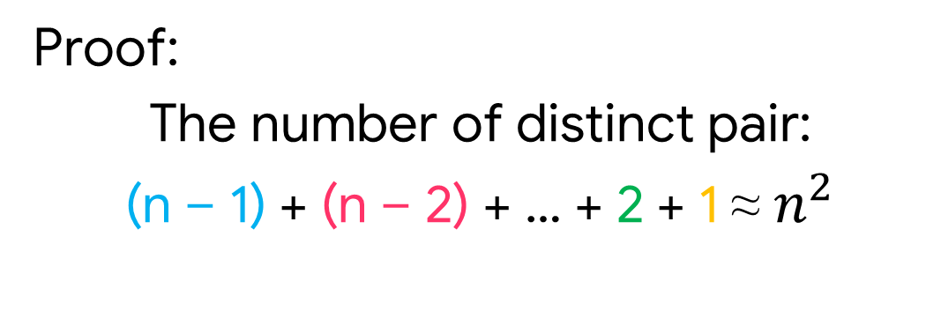

a brute-force method
Proof:
The number of distinct pair:
(n – 1) + (n – 2) + … + 2 + 1 ≈ $n^{2}$
Check all pairs of points u and v with $Θ\left(n^{2}\right)$ comparisons.

Slide 12
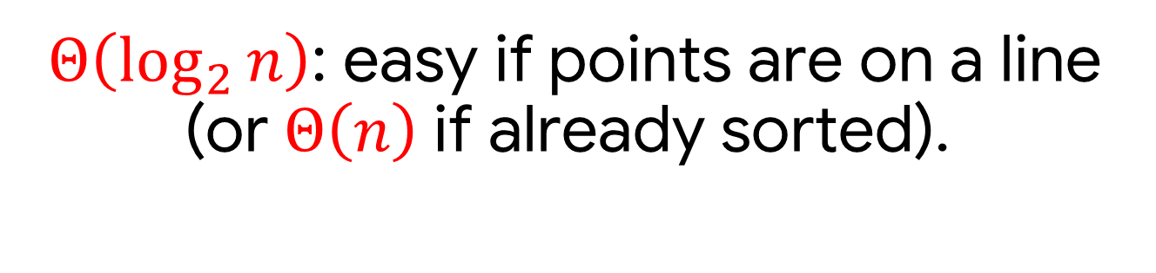
if points are on a line
$Θ\left(\log_{2}{n}\right)$: easy if points are on a line (or $Θ\left(n\right)$if already sorted).

Slide 13
How would a divide & conquer approach look like?
divide
conquer

Slide 14
divide
conquer

Slide 15
divide
conquer
Draw vertical line F so that roughly ½ n points on each side

Slide 16
divide
conquer
Draw vertical line F so that roughly ½ n points on each side

Slide 17
divide
conquer
Draw vertical line F so that roughly ½ n points on each side
Find closest pair in each side recursively

Slide 18
divide
&
conquer
Draw vertical line F so that roughly ½ n points on each side
Find closest pair in each side recursively

Slide 19
&
divide
conquer
Find closest pair with one point on each side
Draw vertical line F so that roughly ½ n points on each side
Find closest pair in each side recursively

Slide 20
&
divide
conquer
Find closest pair with one point on each side
Draw vertical line F so that roughly ½ n points on each side
Find closest pair in each side recursively

Slide 21
Find closest pair with one point on each side
&
To combine, do we need to consider all points on the left & right of F?

Slide 22


Find closest pair with one point on each side
&
To combine, do we need to consider all points on the left & right of F?
$$δ_{2}$$
$$δ_{1}$$

Slide 23


Find closest pair with one point on each side
&
To combine, do we need to consider all points on the left & right of F?
$$δ_{2}$$
$$δ_{1}$$
$$δ_{1}$$
$$δ_{2}$$

Slide 24
Find closest pair with one point on each side
&
To combine, do we need to consider all points on the left & right of F?
$$δ_{2}$$
$$δ_{1}$$
$$δ_{1}$$

Slide 25
Find closest pair with one point on each side
&
To combine, do we need to consider all points on the left & right of F?
$$δ_{2}$$
$$δ_{1}$$
$$δ_{1}$$

Slide 26
Find closest pair with one point on each side
&
To combine, do we need to consider all points on the left & right of F?
Only need to consider points within $δ$ of line F.
$$δ_{2}$$
$$δ_{1}$$
$$δ_{1}$$

Slide 27


&
Only need to consider points within $δ$ of line F.
Let $P_{y}$ be an array of the points in that region, sorted by decreasing y-coordinate value.
$$δ_{1}$$
$P_{y}$ might contain all the points, we can’t check every pair.

Slide 28
&
Only need to consider points within $δ$ of line F.
$$δ_{1}$$
Suppose $P_{y}=p_{1},p_{2},…, p_{m}$. If ${dist\{p}_{i},p_{j}\}$ < $δ$ then |i – j|$≤δ$

Slide 29
&
Only need to consider points within $δ$ of line F.
Proof.
$$δ_{1}$$

Slide 30



&
Only need to consider points within $δ$ of line F.
$$\frac{δ}{2}$$
Proof.
$$\frac{δ}{2}$$
At most 1 in each box because each box is completely contained in one half and no two points in a half are closer than $δ$
$$δ_{1}$$

Slide 31
&
Only need to consider points within $δ$ of line F.
$$\frac{δ}{2}$$
Proof.
$$\frac{δ}{2}$$
At most 1 in each box because each box is completely contained in one half and no two points in a half are closer than $δ$
At least 3 full rows separate 2 points if |i – j|> $δ$.
$$δ_{1}$$

Slide 32
&
Only need to consider points within $δ$ of line F.
$$\frac{δ}{2}$$
$$\frac{δ}{2}$$
Only consider points within 0, 1 or 2 rows.
$$δ_{1}$$

Slide 33
How would pseudocode look like?

Slide 34

closestPair(Px, Py): if |Px| == 2: return Edist(Px[1], Px[2]) //base d1 = closestPair(FirstHalf(Px, Py)) //divide d2 = closestPair(SecondHalf(Px, Py)) d = min(d1, d2) Sy = Points in Py within $δ$ // merge For i = 1, …, |Sy|: For j = 1, …, $δ$: d = min(d, Edist(Sy[i], Sy[j])) return d

Slide 35

Total running time:
Divide set of points in half each time: $Θ\left(\log_{2}{n}\right)$
Merge takes: $Θ\left(n\right)$
Recurrence: $T\left(n\right)≤2T\left(\frac{n}{2}\right)+C$
➔ $Θ\left({nlog}_{2}{n}\right)$time

Slide 36
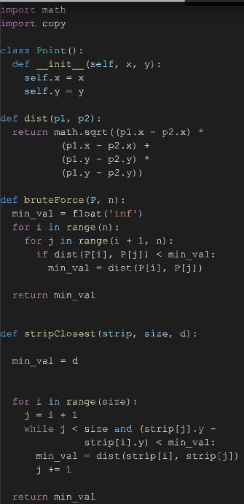
Geeksforgeeks
Nhóm 2,4,6,7

Slide 37
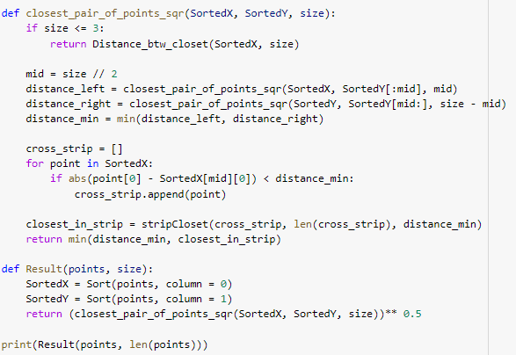
Nhóm 10

Slide 38
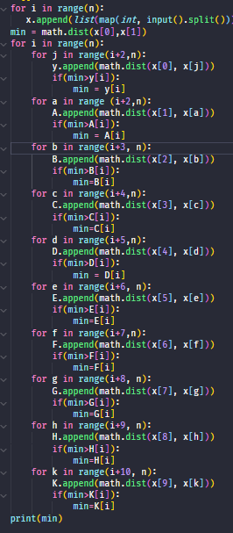
Nhóm 9

Slide 39
End.

